Slide 1
Ban Info
Ryan McDonnell
Maya Tung

Slide 2
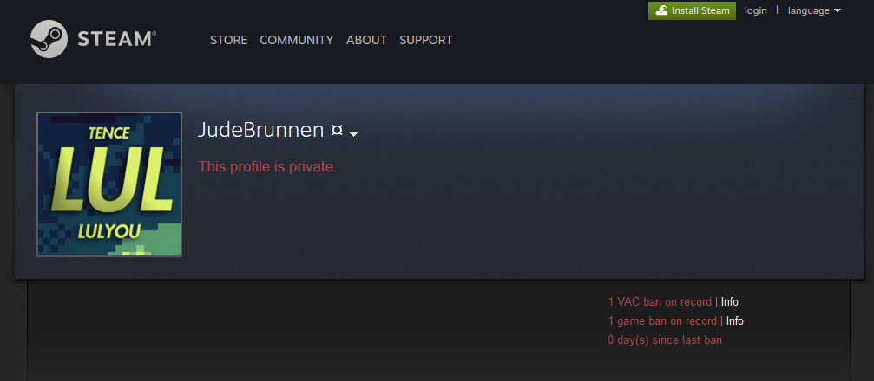
Steam and VAC
Distribution platform made by Valve
Many services offered
Large economy
10-17 million online accounts
Valve Anti Cheat
Other bans
Community ban
Economy ban

Slide 3
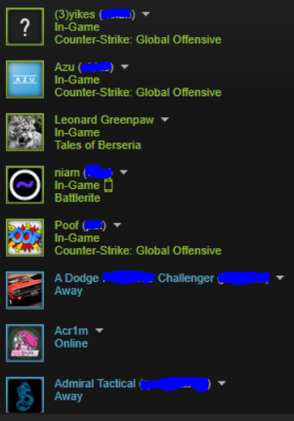
What we do and what’s out there already
Take a steam id and get info about them and their list of friends
Are they banned? Is a friend banned? How many steps until a ban is found?
Could be manually done but would be time consuming, 250 friends or more
Focus areas
Blend of 3, 4, and 5
Pulling data from database and files
Putting data into a database and reading from it
Vac-ban.com
Currently has expired certificate
Only shows ban waves

Slide 4
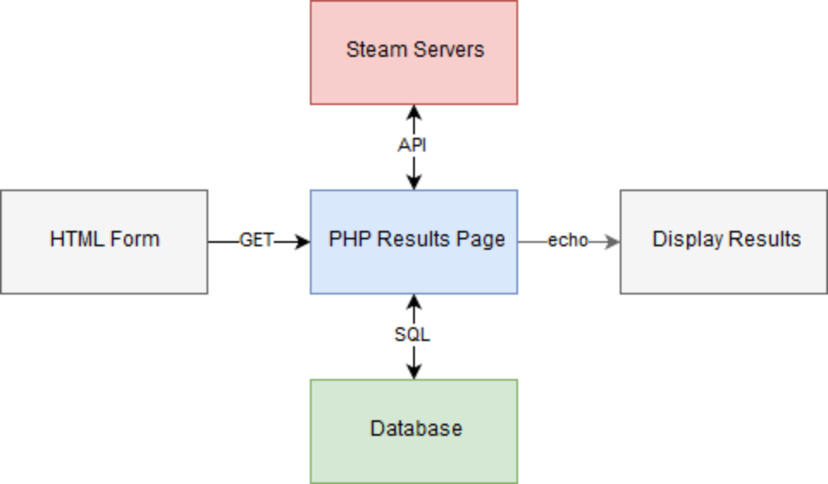

Slide 5
ResolveVanityURL
GetPlayerBans
GetFriendList
GetPlayerSummaries

Slide 6
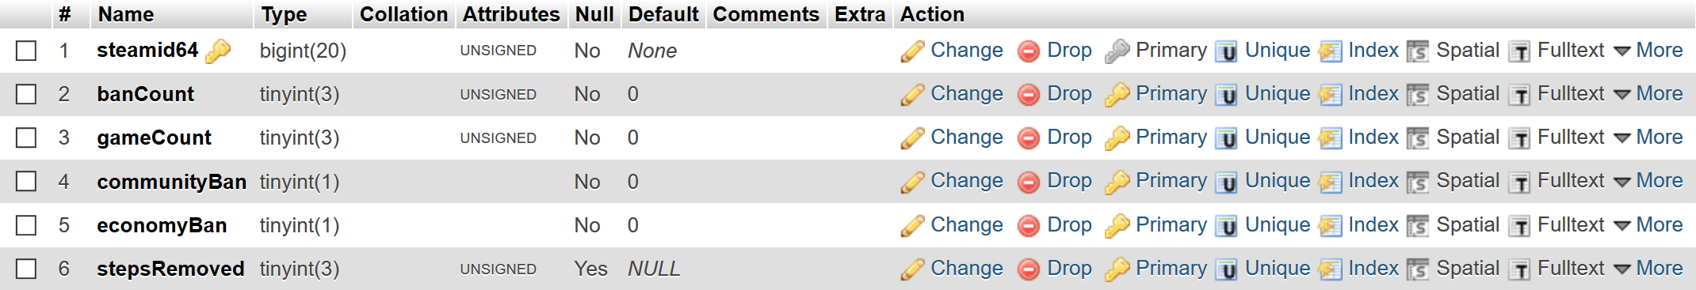
SteamID64s are currently 17 digits long
There are currently 72 games which use VAC
the chance of less than 1 out to two steps (a friend of a friend is banned) if both have 68 friends is 1.856*10^-187 using an average of 9% of Steam users having some type of ban. 68 was used because average user has 68 friends.

Slide 7
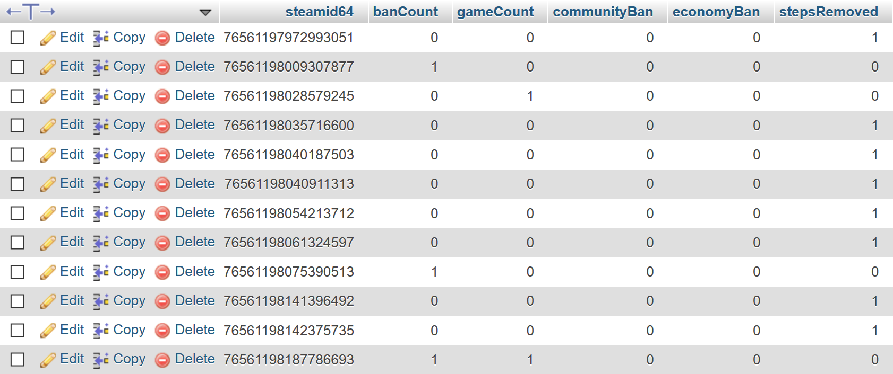

Slide 8
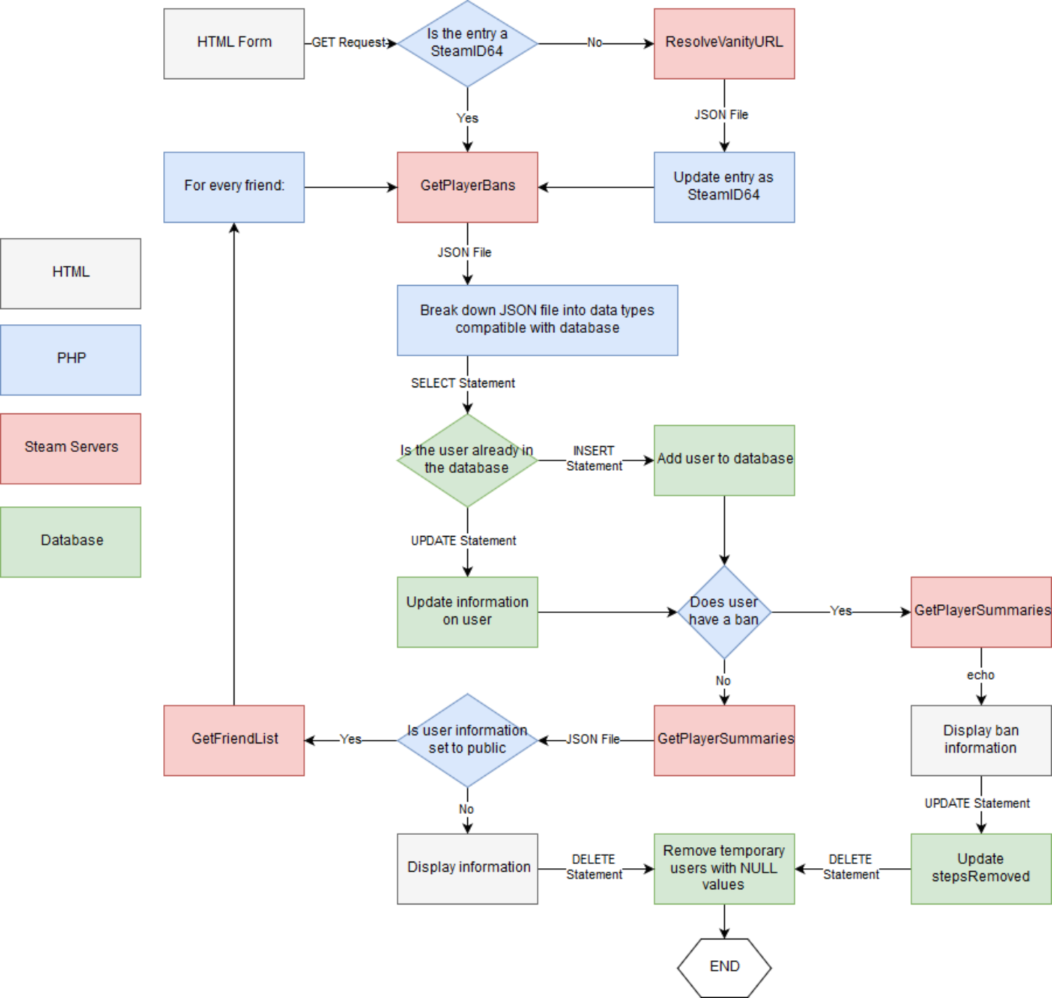

Slide 9
Demo!
Notes:
TickL
Jade_Vanadium
Valeriskers

Slide 10
Future improvements
Search the majority of Steam servers and analyze them (average steps removed, number of people banned, etc)
More statistics (average number of friends, games, achievements, etc)
Better UI
Report anomalous users to Steam, in which users have set personal information to public but GetFriendList returns nothing

Slide 11
Questions?

